Slide 1
Converged Optimizer
Mar, 2024

Slide 2
Contents
Motivation
Optimizer for SQL/PGQ
Overview
Experimental Results

Slide 3
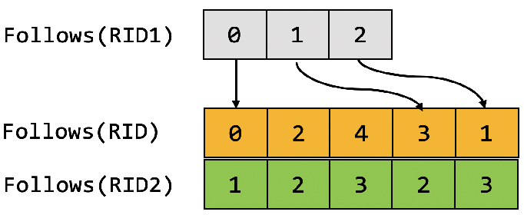
Motivation (Graph Indices)
Extended Table: Person
Extended Table: Follows
Row ID
0
1
2
3
ID | Name
101 | Mahinda
202 | Karim
303 | Carmen
404 | Zhang
Row ID
0
1
2
3
4
ID1 | Row ID1 | ID2 | Row ID2 | Year
101 | 0 | 202 | 1 | 2021
303 | 2 | 404 | 3 | 2019
101 | 0 | 303 | 2 | 2021
202 | 1 | 303 | 2 | 2020
101 | 0 | 404 | 3 | 2021
3
What about Hash Join: Person $⋈$ Follows (Follows.ID1=Person.ID)
Source Vertex ID
Person.RowID
Add Indexes In CSR Format
The Index is stored in the memory
Adj Edge ID
Follows.RowID
Adj Vertex ID
Person.RowID

Slide 4
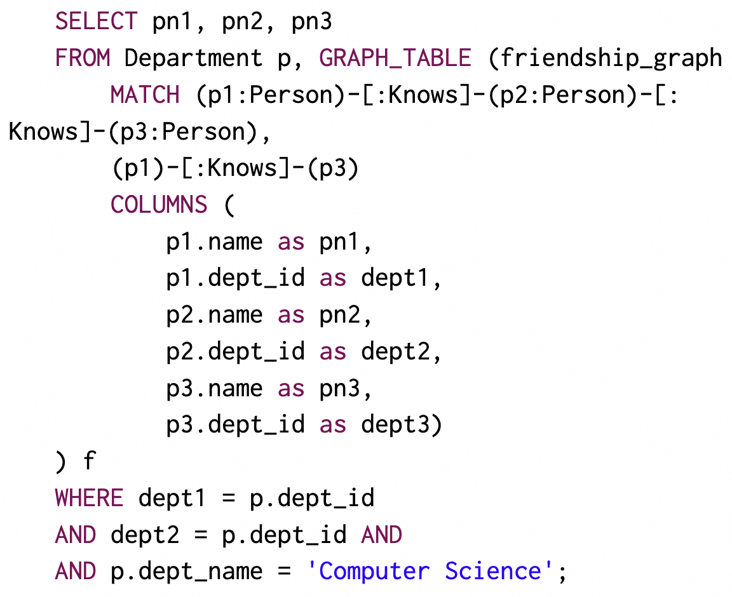
SQL/PGQ
find three persons knowing each other, and two of them are from the department of ‘Computer Science’
Relational Query
Graph Indices are built
Adj(e)
- get adjacent vertices
Adj(v)
- get adjacent edges
Neighbor(v)
- get neighborhoods
How to optimize with graph indices
Graph Query
Relational Query

Slide 5
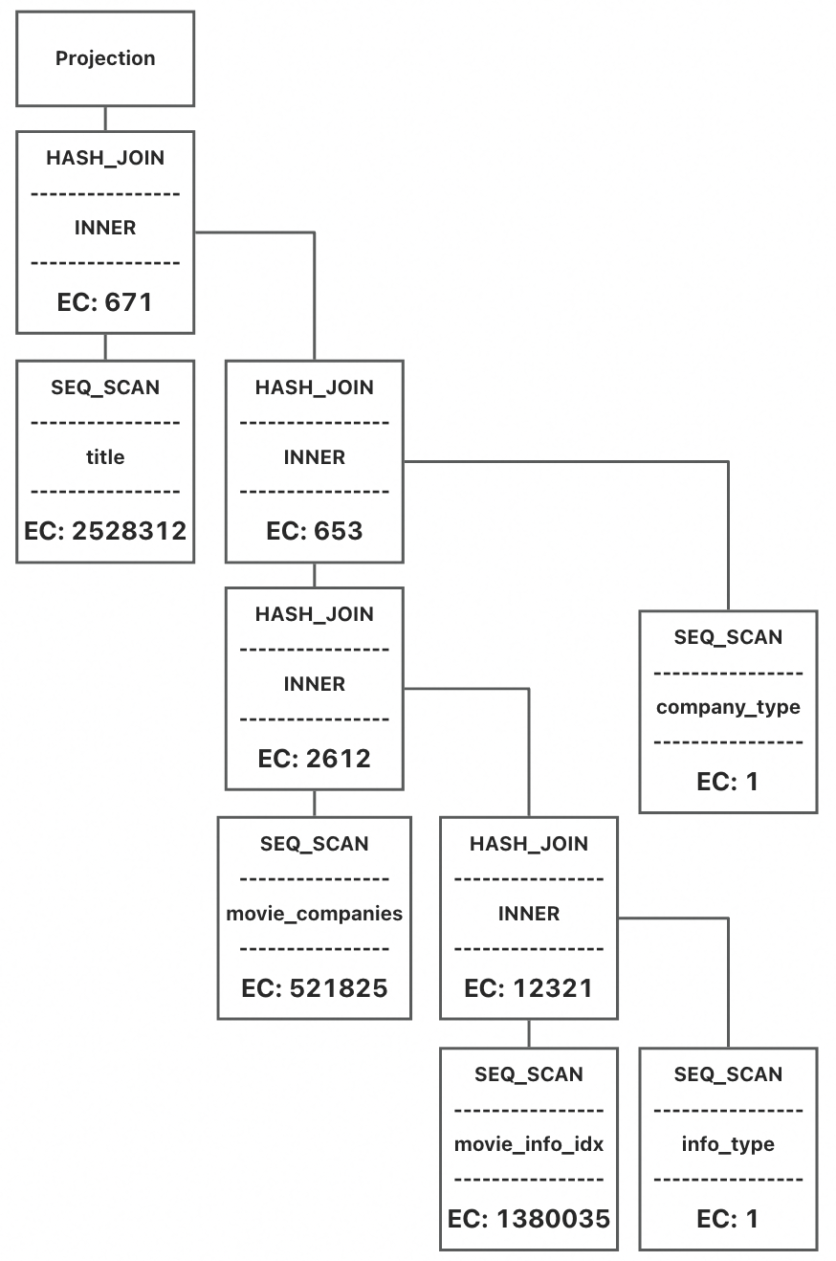
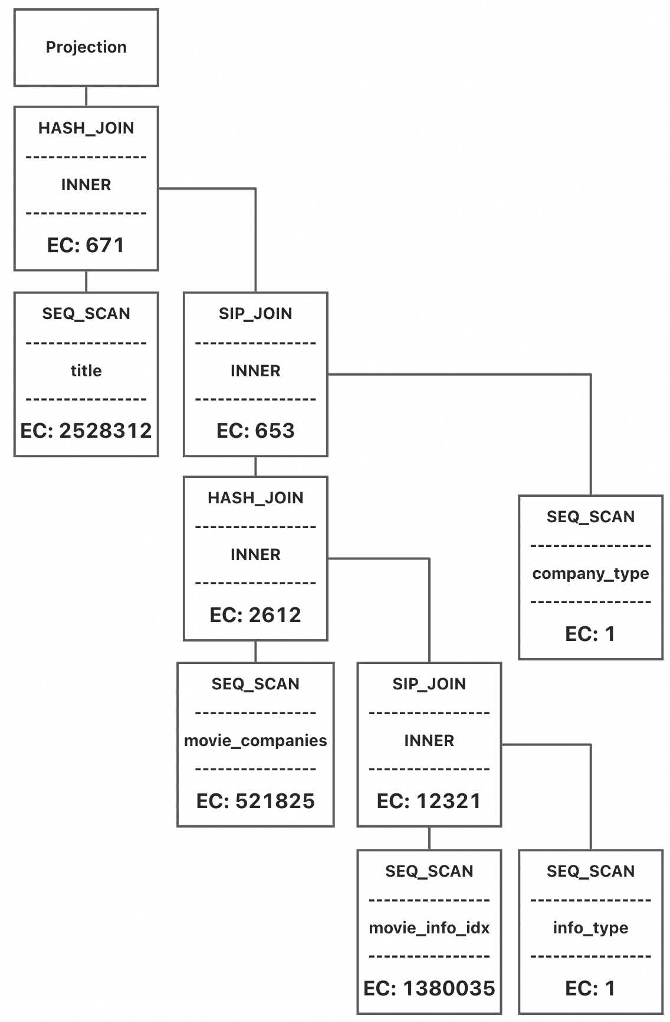
Optimizer for SQL/PGQ
GrainDB
Translate graph queries to
relational queries, and
introduce index-based joins

Slide 6
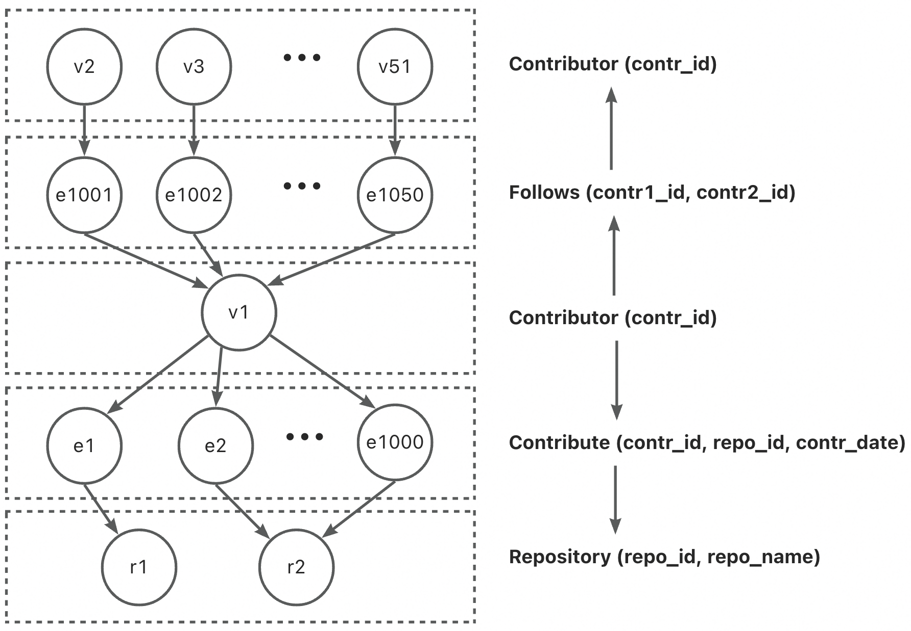
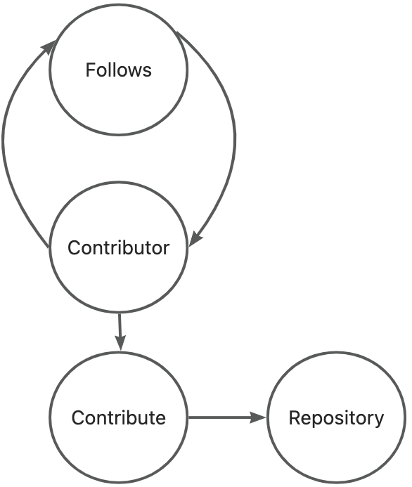
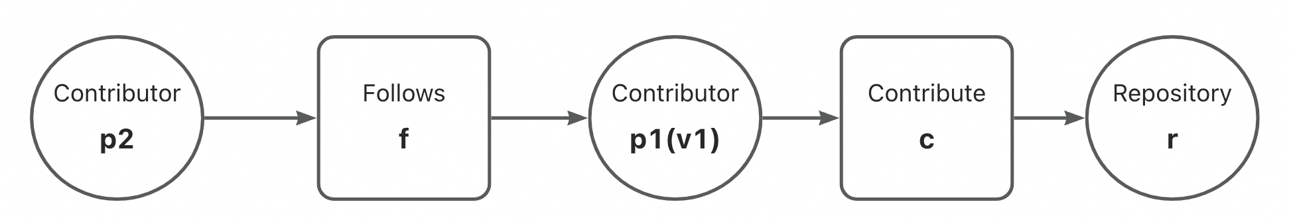
Optimizer for SQL/PGQ
GrainDB
Translate graph queries to relational queries, and introduce index-based joins
find the contributors v1 is following,
and repos v1 contributing to
$p1→f→p2→c→r⇒$ Contributor $→$Follows $→$Contributor $→$Contribute $→$Repository
$$⇒p1→p2→r$$

Slide 7
Optimizer for SQL/PGQ
GrainDB
Translate graph queries to relational queries, and introduce index-based joins
find the contributors v1 is following,
and repos v1 contributing to
$p1→f→p2→c→r⇒$ Contributor $→$Follows $→$Contributor $→$Contribute $→$Repository
$$⇒p1→p2→r$$

Slide 8
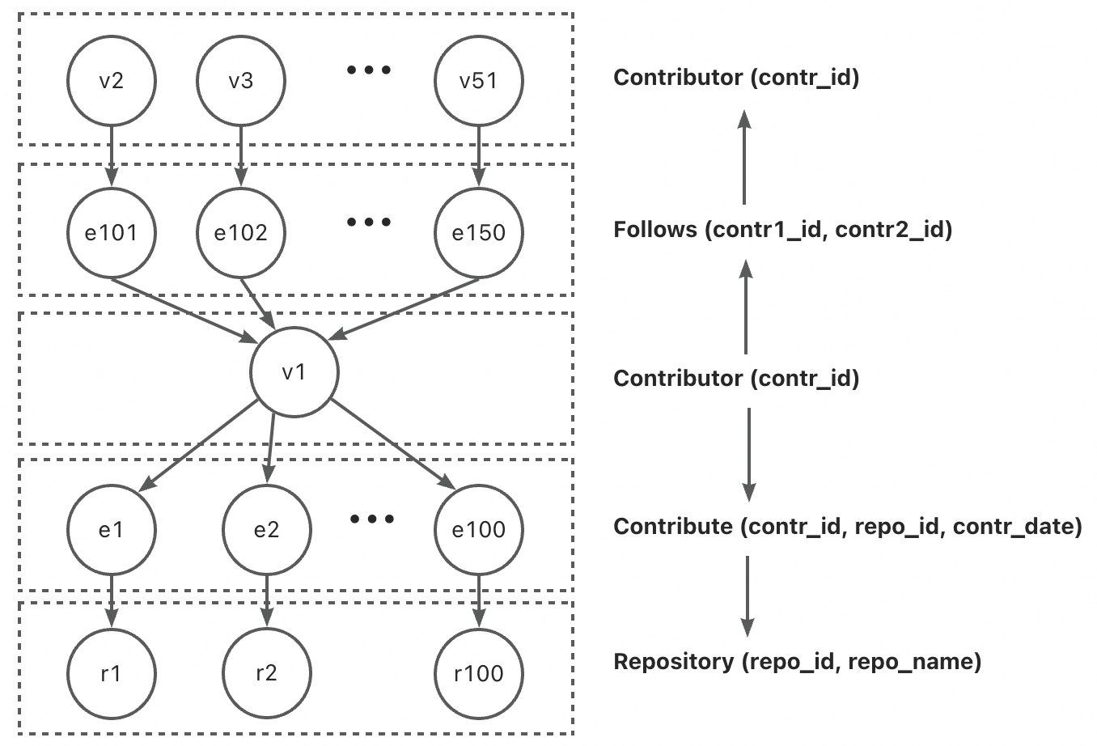
Optimizer for SQL/PGQ
GrainDB
$p1→f→c→p2→r⇒$ Contributor $→$Follows $→$Contribute $→$ Contributor $→$Repository
$⇒$Hash join cannot be replaced with GetNeighbor

Slide 9
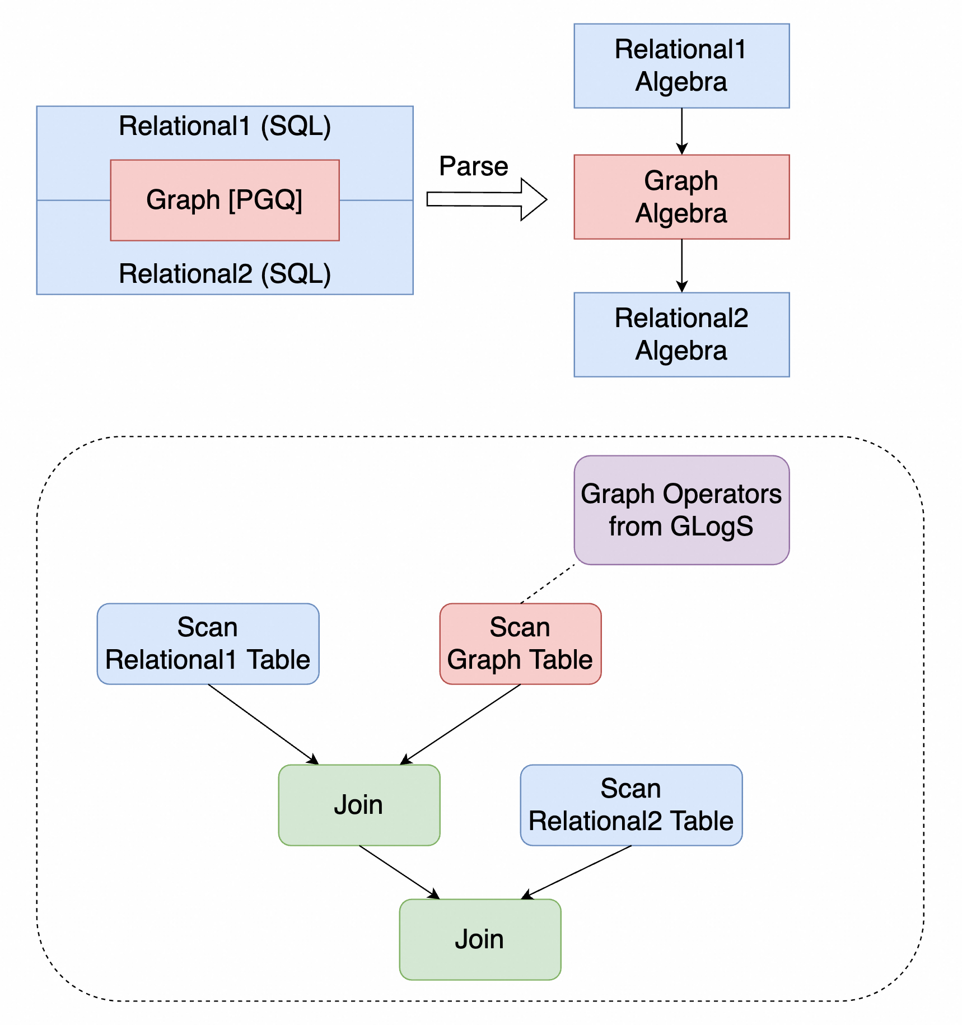
Overview

Slide 10
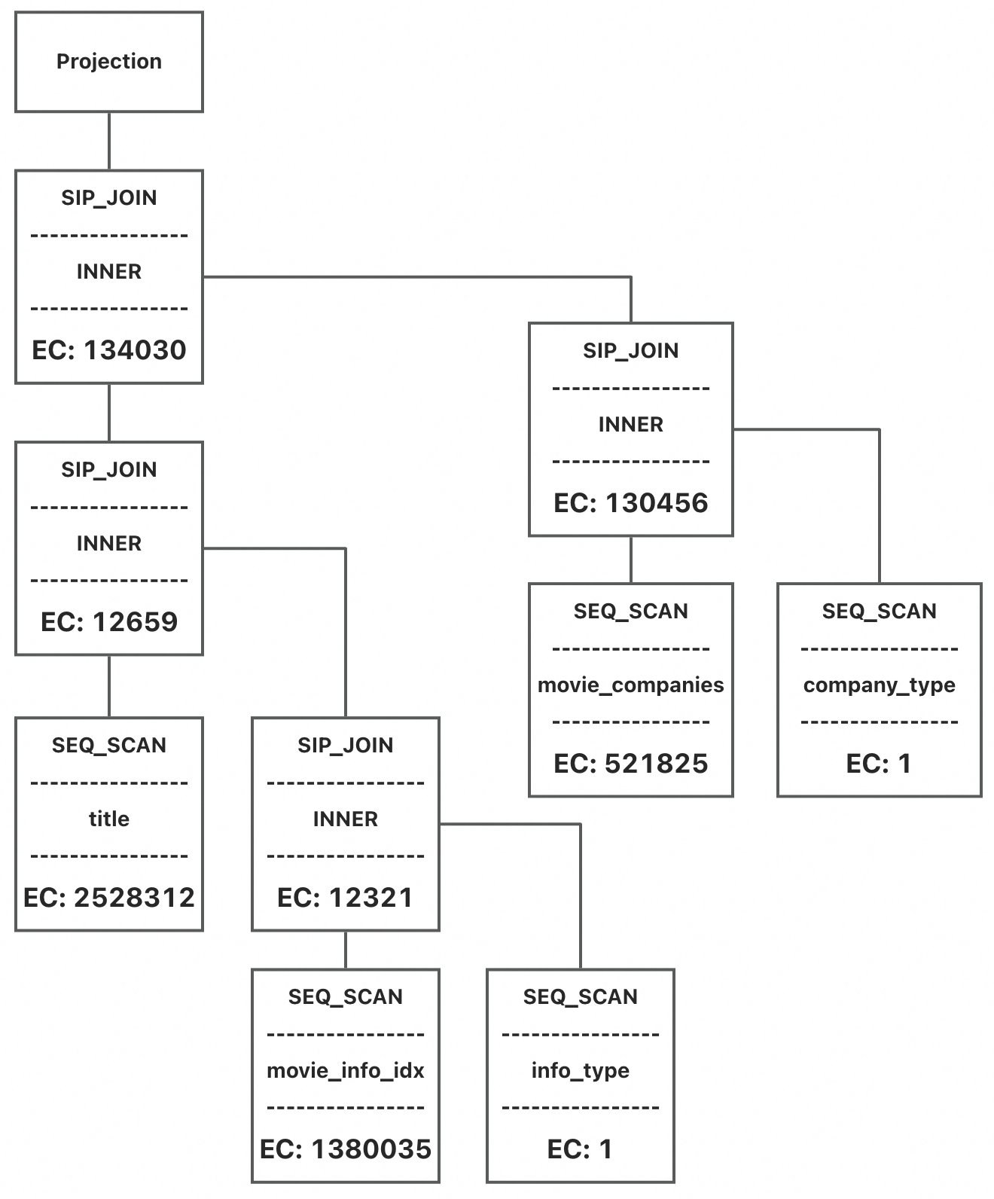
Overview
Benefit 1: Better Cost Estimation
GrainDB: (112ms)
Hash Cost: 4445760
True Cost: 2686677
Ours: (19ms)
Hash Cost: 4585610
True Cost: 168097

Slide 11
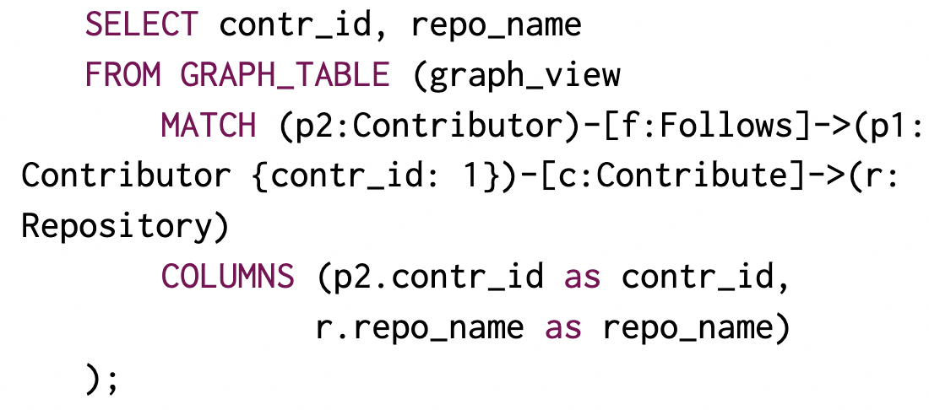
Overview
Benefit 2: Better Leveraging Graph Indices
That is, in the graph query, cost of GetNeighbor is considered in finding the optimal plan
$p1→f→c→p2→r⇒$ Contributor $→$Follows $→$Contribute $→$ Contributor $→$Repository
$⇒$Hash join cannot be replaced with GetNeighbor

Slide 12
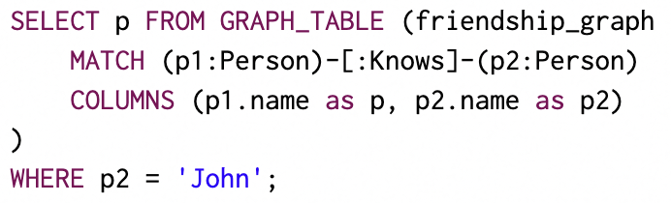
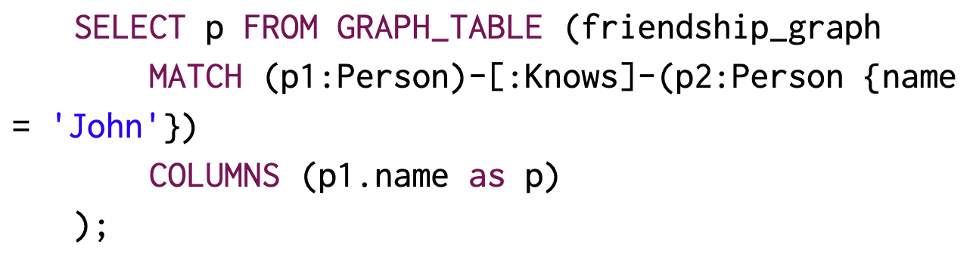
Overview
Benefit 3: FilterIntoMatchRule & SetPullupRule
FilterIntoMatchRule

Slide 13
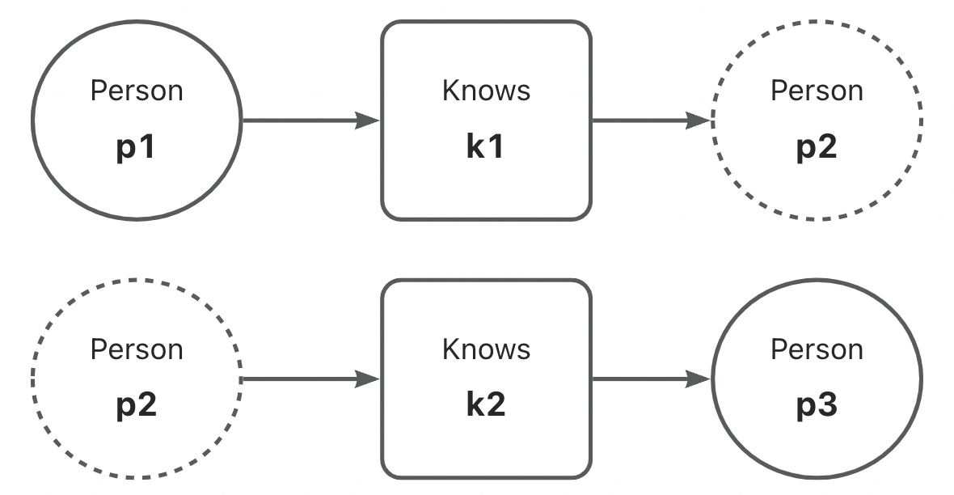
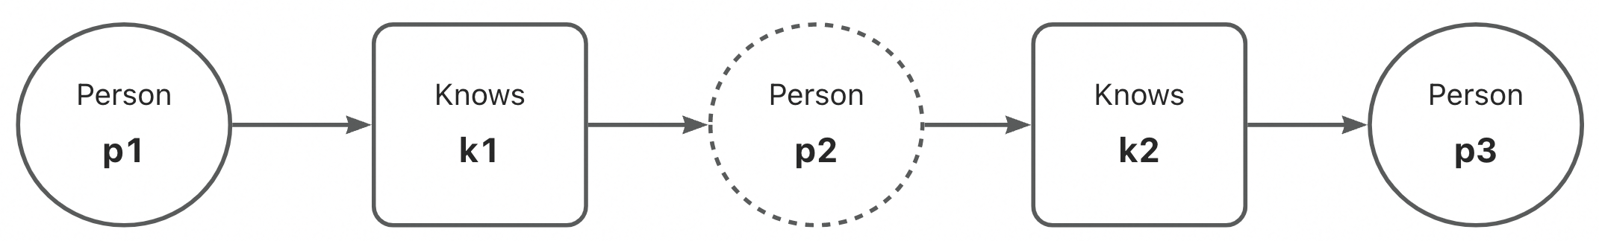
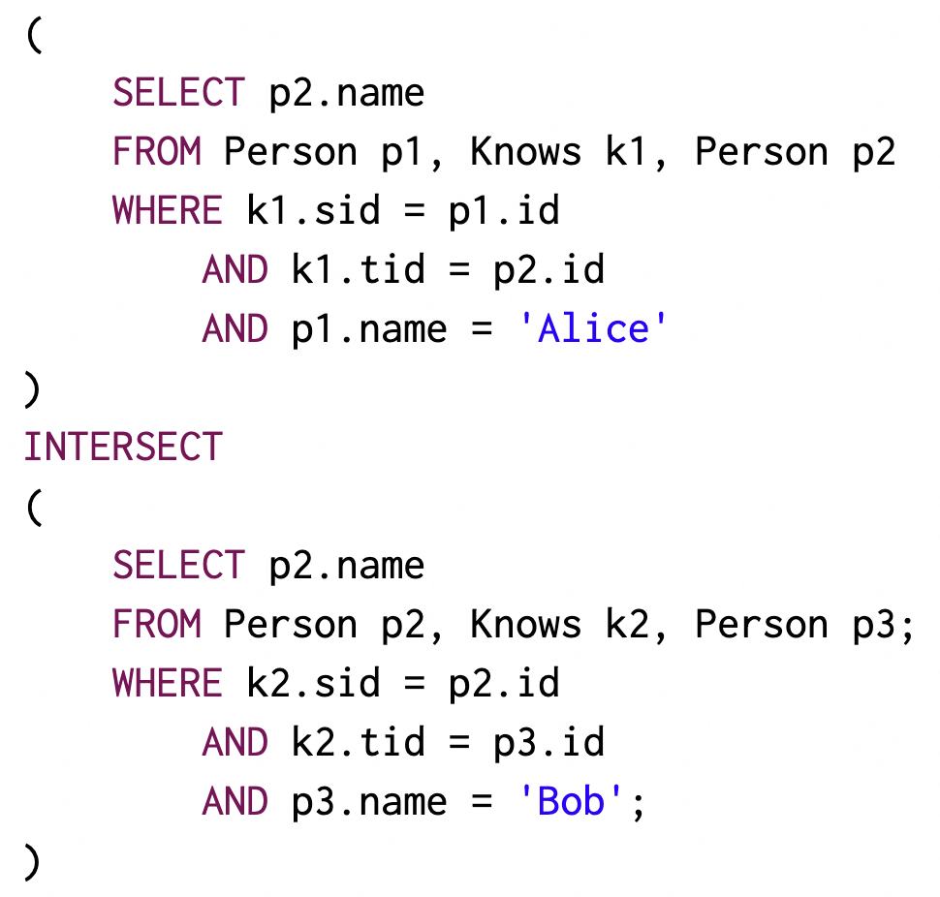
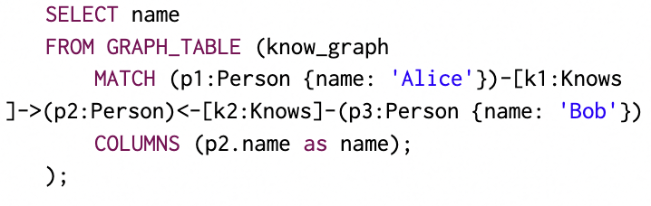
Overview
Benefit 3: FilterIntoMatchRule & SetPullupRule
SetPullupRule

Slide 14
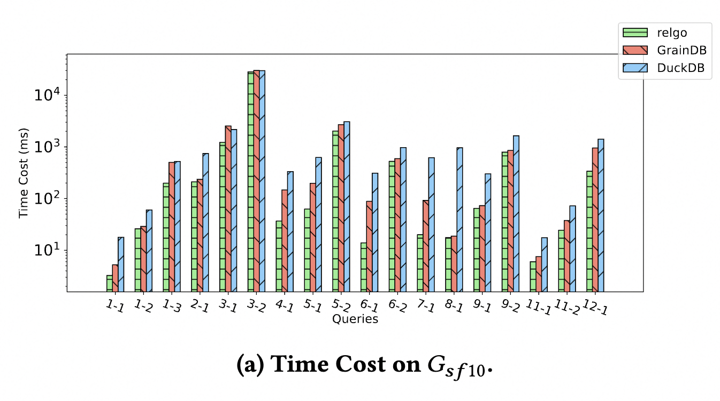
Experimental Results

Slide 15
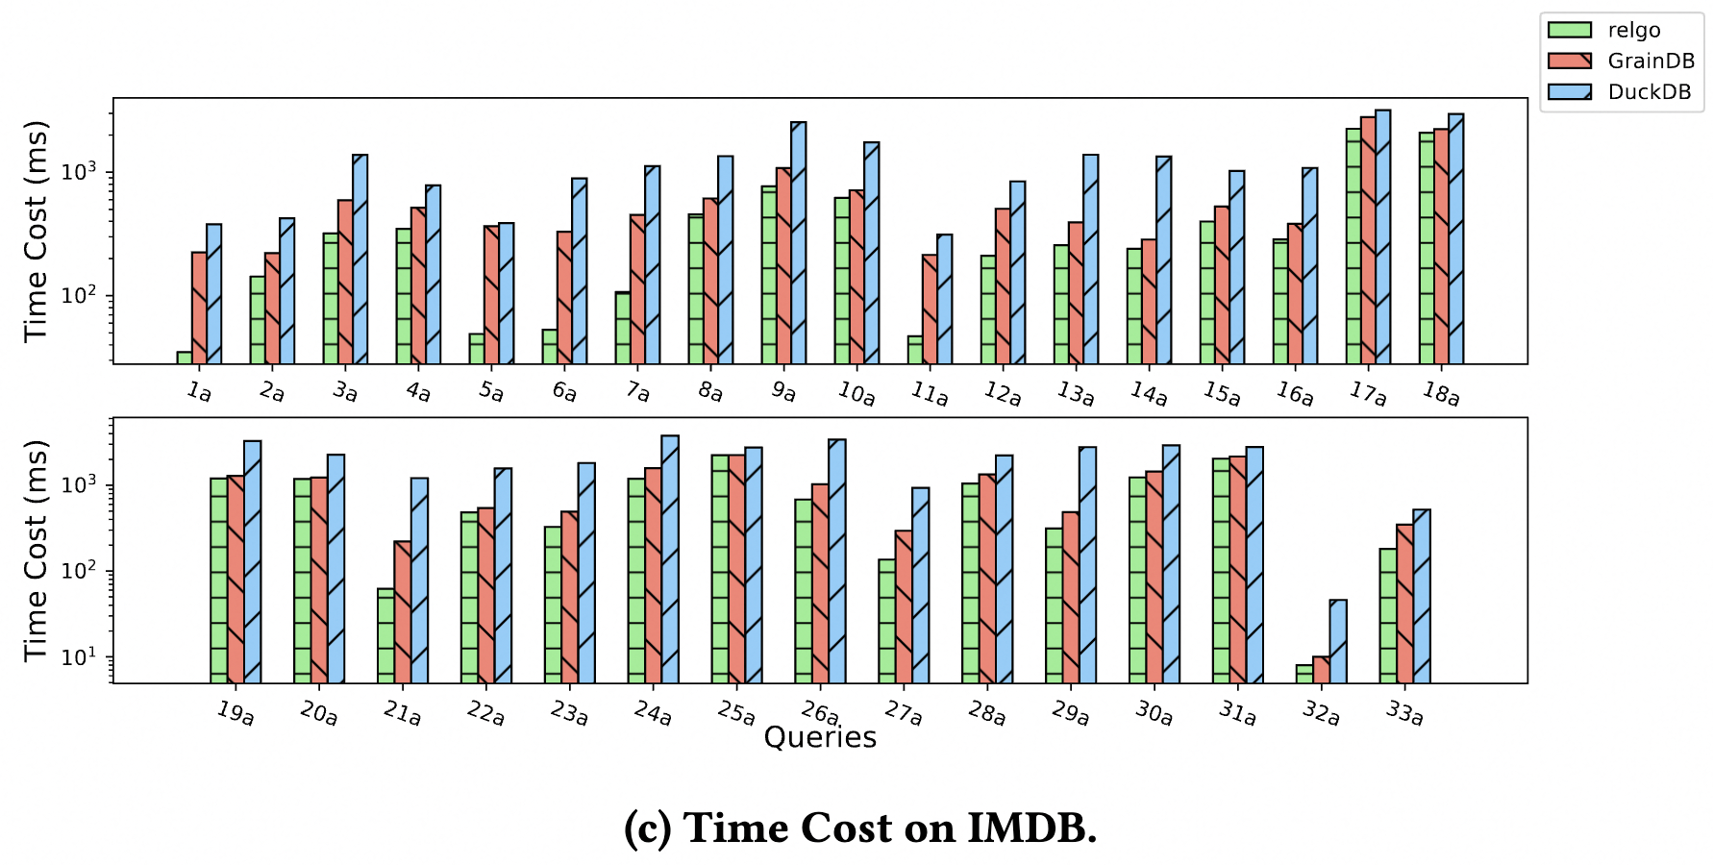
Experimental Results

Slide 16
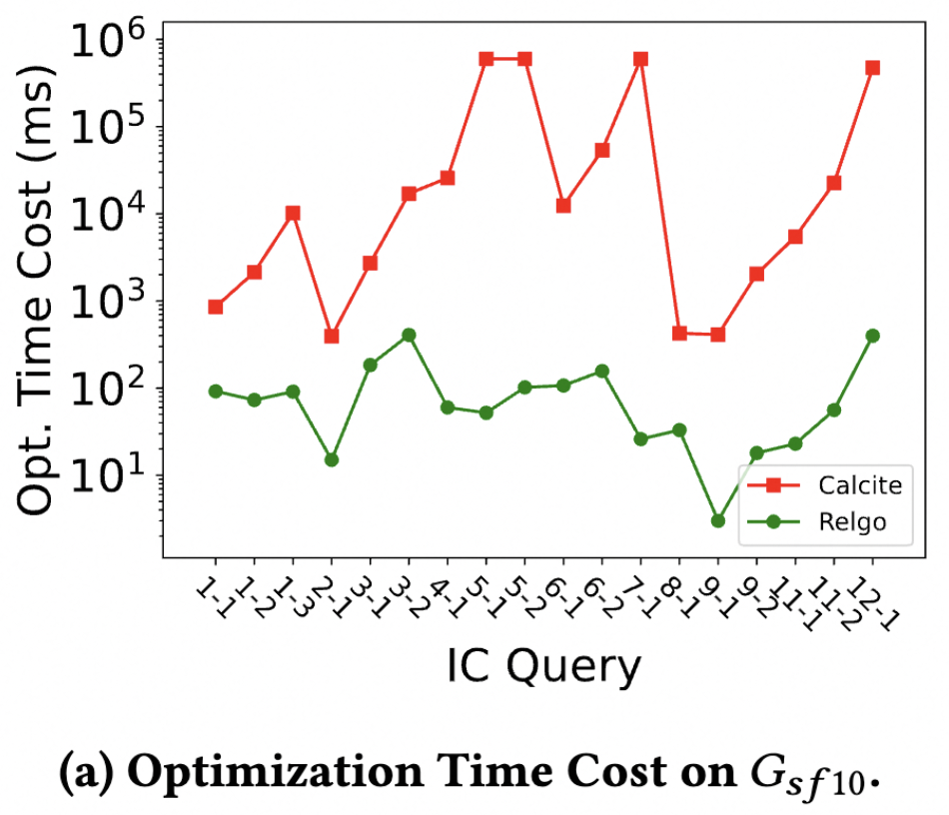
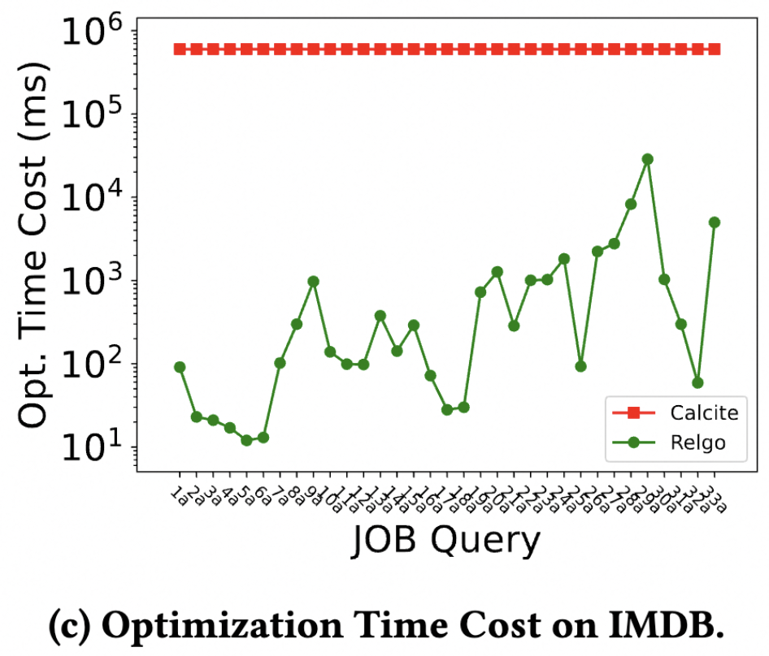
Experimental Results

Slide 17
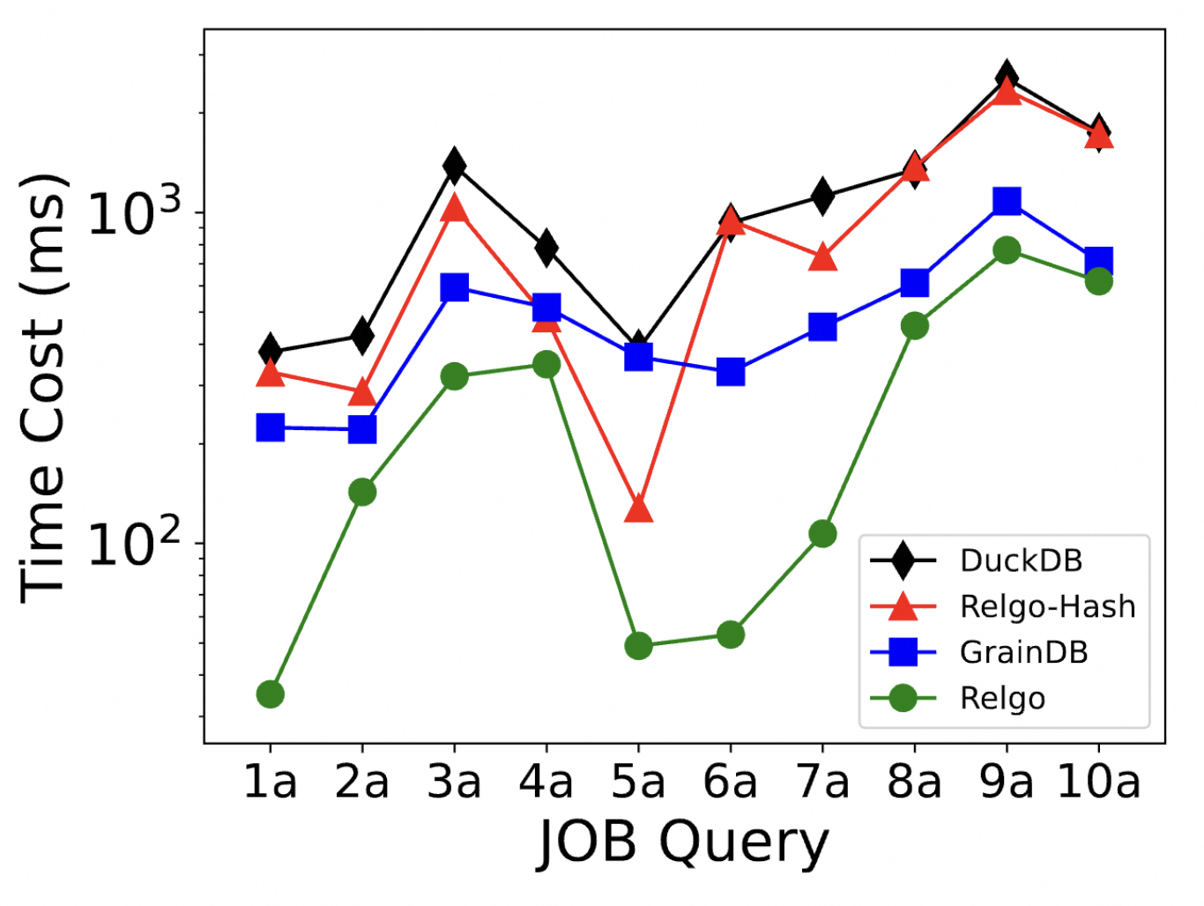
Experimental Results

